Slide 1
Research Question: How does Jojo Rabbit (2019) deconstruct the genre of war films and the memory of World War II?

Slide 2
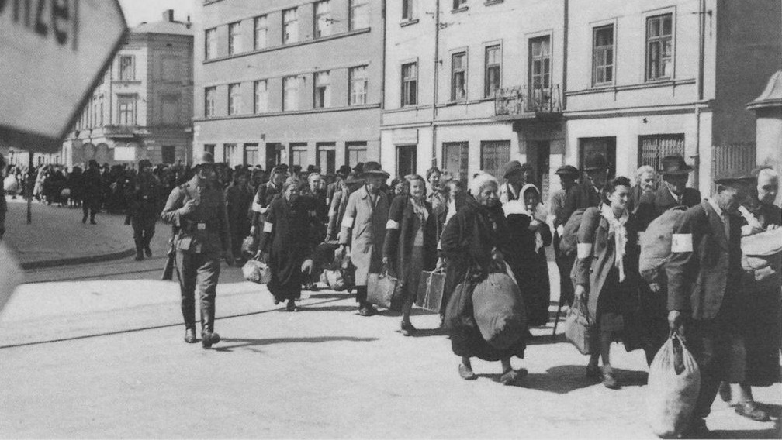
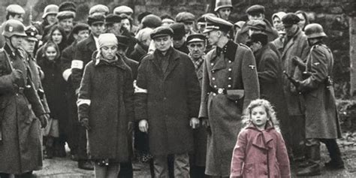
Historical Memory and Film
Images and films can shape our understanding of the past
Prosthetic Memories
Can also reflect or subvert our understanding of the past

Slide 3
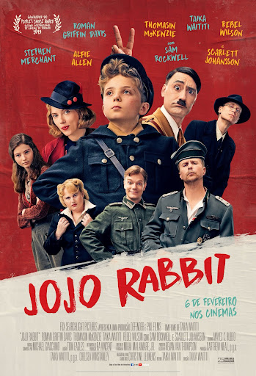
Jojo Rabbit
Directed by Taika Waititi Premiere in 2019.
Outset:
Family Betzler in Falkenheim in Nazi Germany during the last 6 months of the war. Jojo is injured and stays at home. Has an imaginary friend, Adolf.
Main Plot:
Jojo finds Elsa in the attic. His mother is killed. Jojo’s understanding of the war changes completely, as does his view of Jews. This is a movie about his journey of coming of age.
Side Plots:
Jojo’s father / his child friend Yorki / officer Klenzendorf
Ending:
American soldiers take over Falkenheim. Jojo survives. As does Elsa.

Slide 4
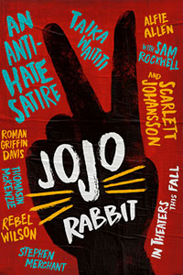
Genre
Genre as “aesthetic structure of affective expectations” (Berlant 4).
Jojo Rabbit challenges the viewer’s expectations when watching a WW2 movie.
Also challenges the expectations of a kids movie.
Leads to a estrangement or defamiliarization of the viewer.

Slide 5
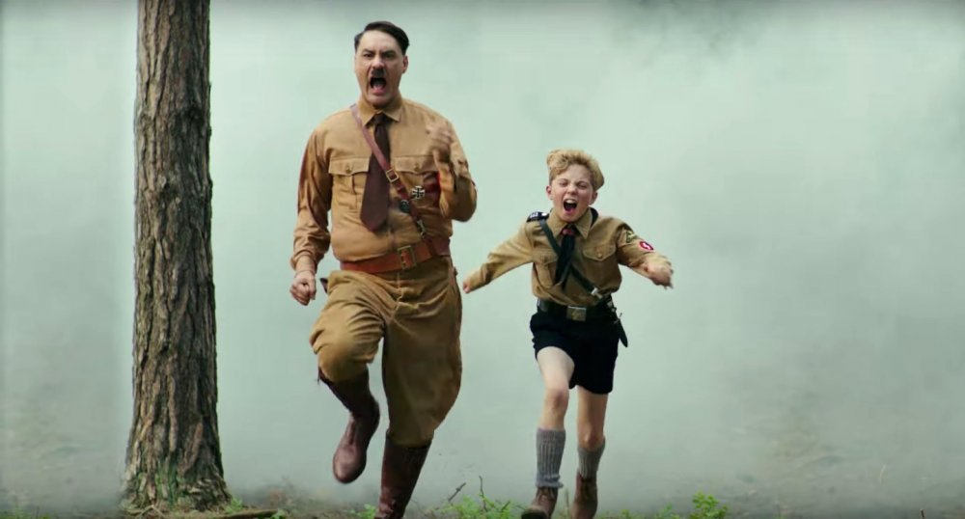
Comedy, Satire and Humor
The movie deconstructs WWII representations by using humor
It makes reference to the representability of WWII in pop culture through exaggeration
The performative aspect of Nazi Germany is satirized
Satirical depictions of Nazi Germany as controversial

Slide 6
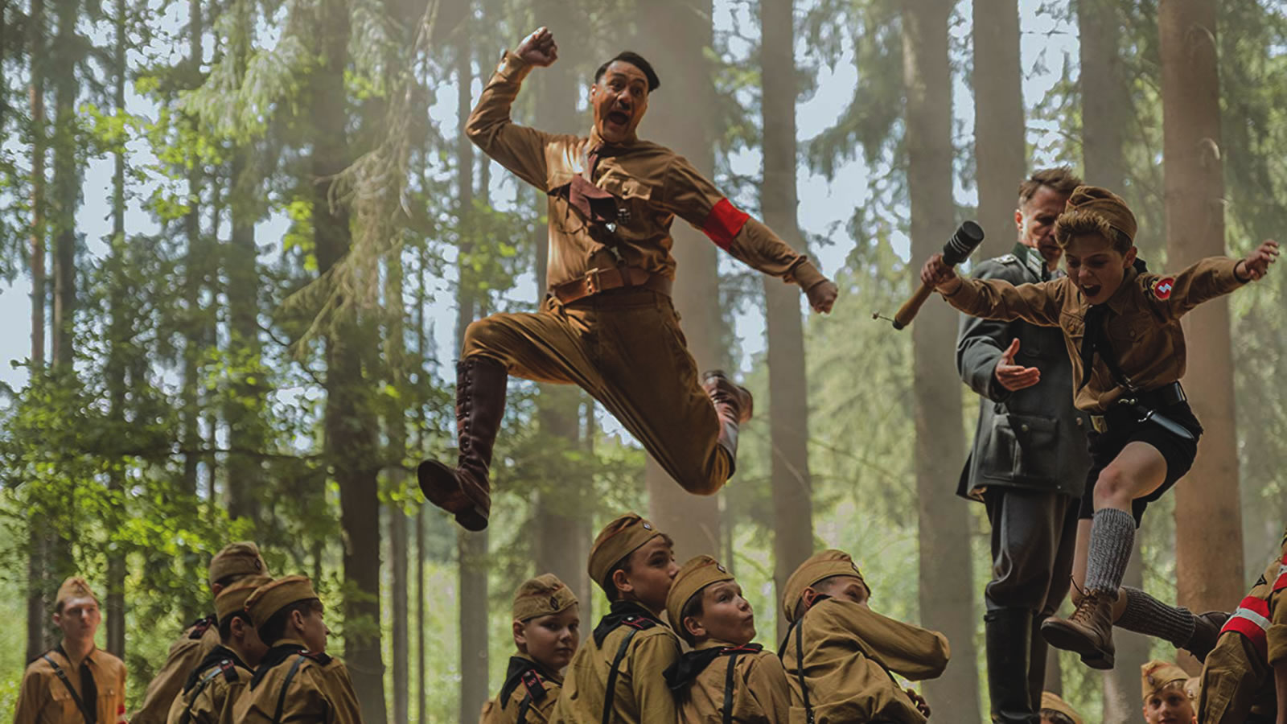
The Use of Satire:
Play and Performance
“You're not a Nazi, Jojo. You're a ten-year-old kid who likes dressing up in a funny uniform and wants to be part of a club”
Everyday performance as key aspect of the Nazi system’s functioning. Mary Fulbrook names this ‘bystander society’
Rehearsal of scripts, through communal practices over time becomes naturalized and enacted.

Slide 7
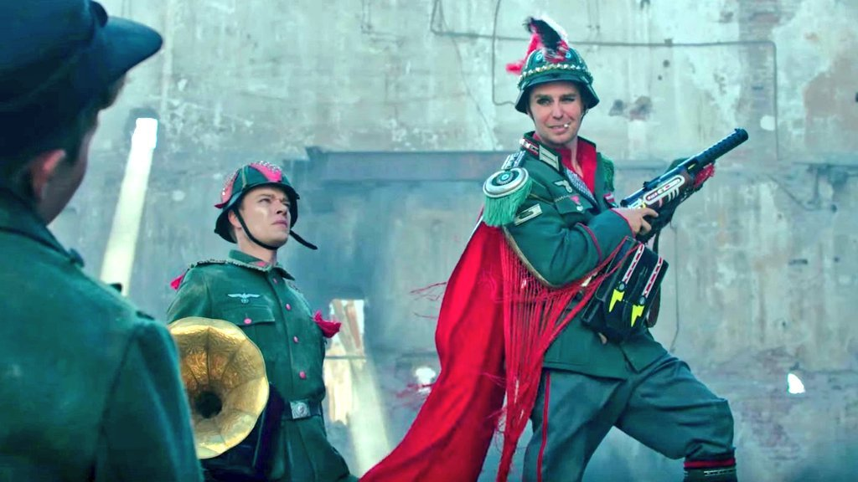
The Use of Satire:
Play and Performance
Jojo Rabbit’s representation of the war through the lens of a child, whose life has been subsumed in rehearsing these scripts, comments on this performative aspect through a satiric angle.
Draws on intertextual references to satirize popular representations of the Nazi regime as enacted solely from participants that are ontologically evil as opposed to discussing the structural participation in the system. Satire enables Jojo Rabbit to scale down to the banal, everyday, communal participation in the Nazi system;

Slide 8
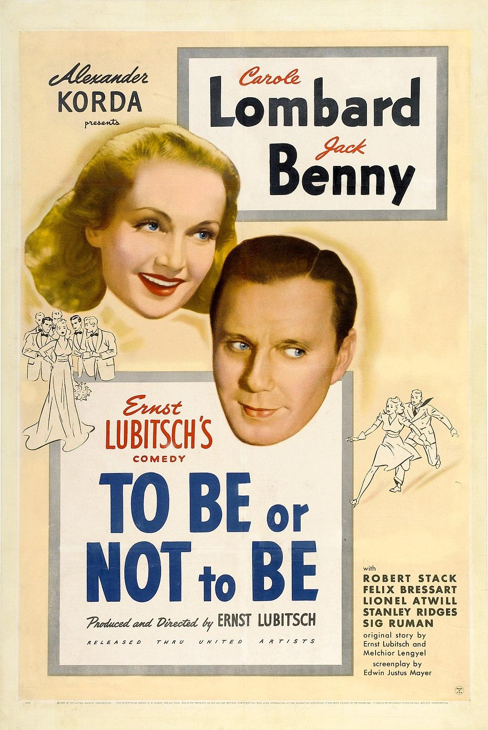
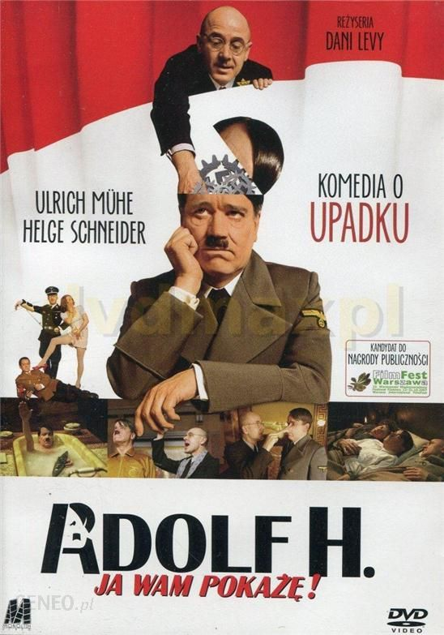
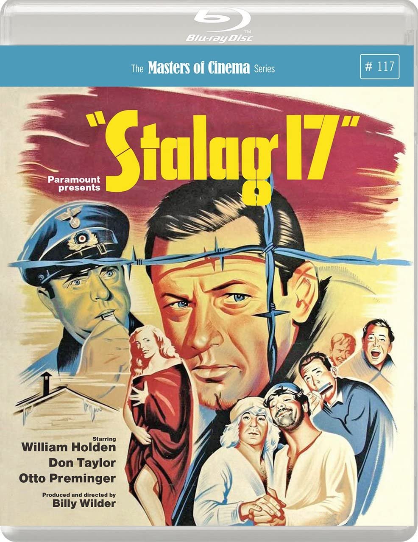
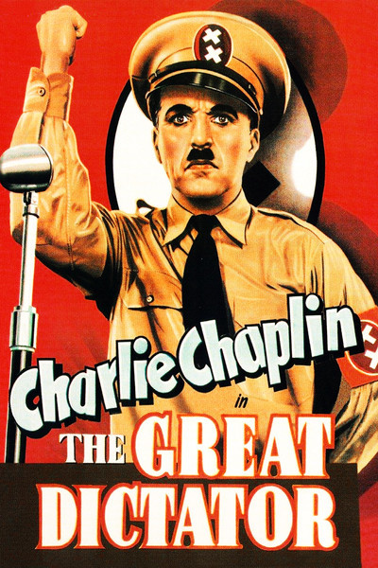
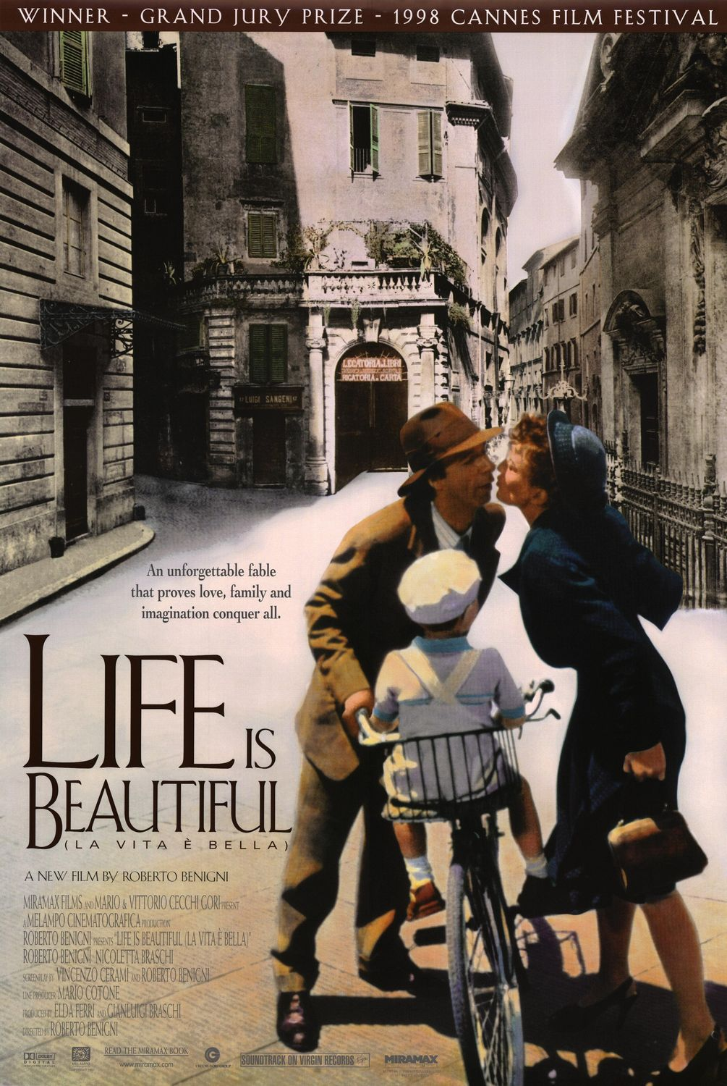
Hitler as Comedic Figure
Use of comedy to portray the historical period of World War II, and in particular, the figure of Hitler in movies (and a range of other aesthetic objects) date from the 1940s.
So, why the controversy in Jojo Rabbit’s reception?
Jojo Rabbit’s international popularity and mass circulation
A satiric angle has not been build up in the collective cultural imagination as an expectation from a WW2 movie.
Production of the movie in a present of intensifying nationalist and racist tendencies. Representations of the past are not self-referential and neither is their reception.

Slide 9
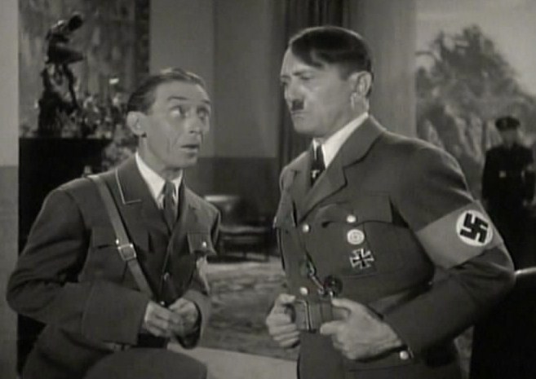
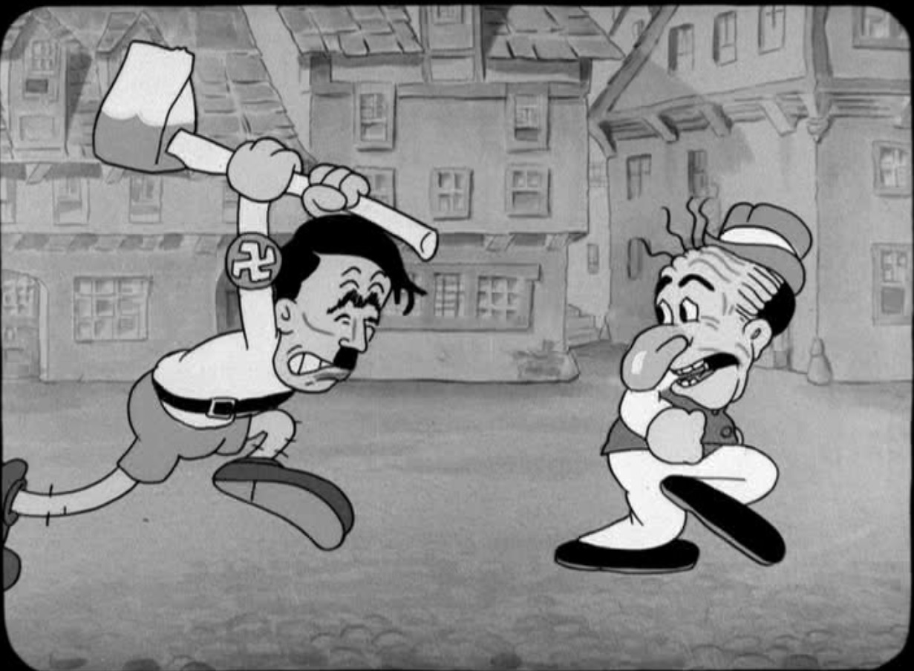
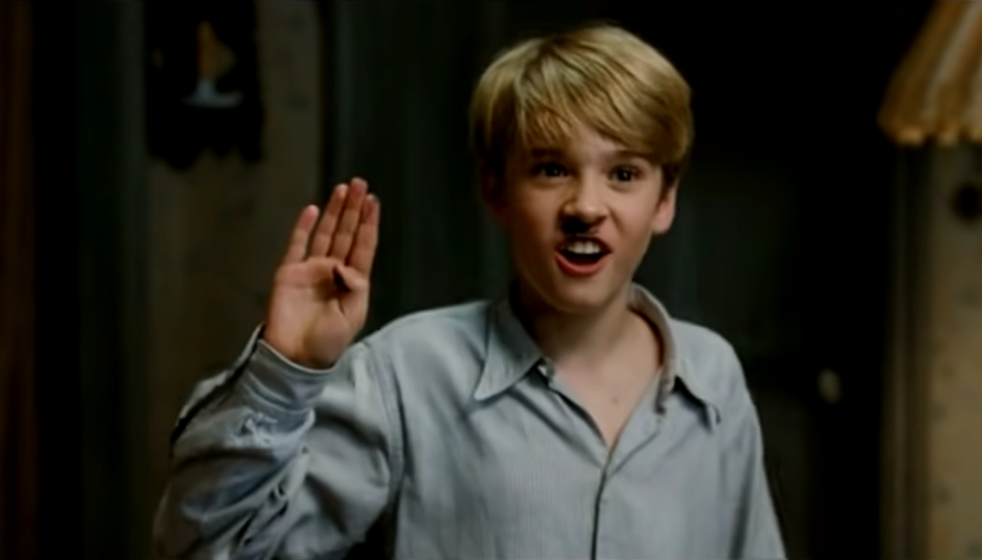
From 1933 to 1945 & since then: Figures of Hitler as a weapon of antinazi propaganda & historical memory, a cartoon & science-fiction character
That Nazty Nuisance, dir. Glenn Tryon (1943).
Bosko’s Picture Show, dir. Hugh Harman (1933)
La Rafle, dir. Roselyne Bosch (2009)
Rick and Morty, S06E08 (2022)
While the political figure depicted belongs primarily to German history, and most films and cartoons parodying Hitler were at least partly produced by German companies, most of the liberties with the interpretation of this figure were taken by directors and actors from WW2 Ally countries.
After La vita è bella, dir. Roberto Benigni (1997), Jojo Rabbit is a new humorous production examining Nazi Germany through the eyes of a child with a vivid imagination and protective parental figures.

Slide 10
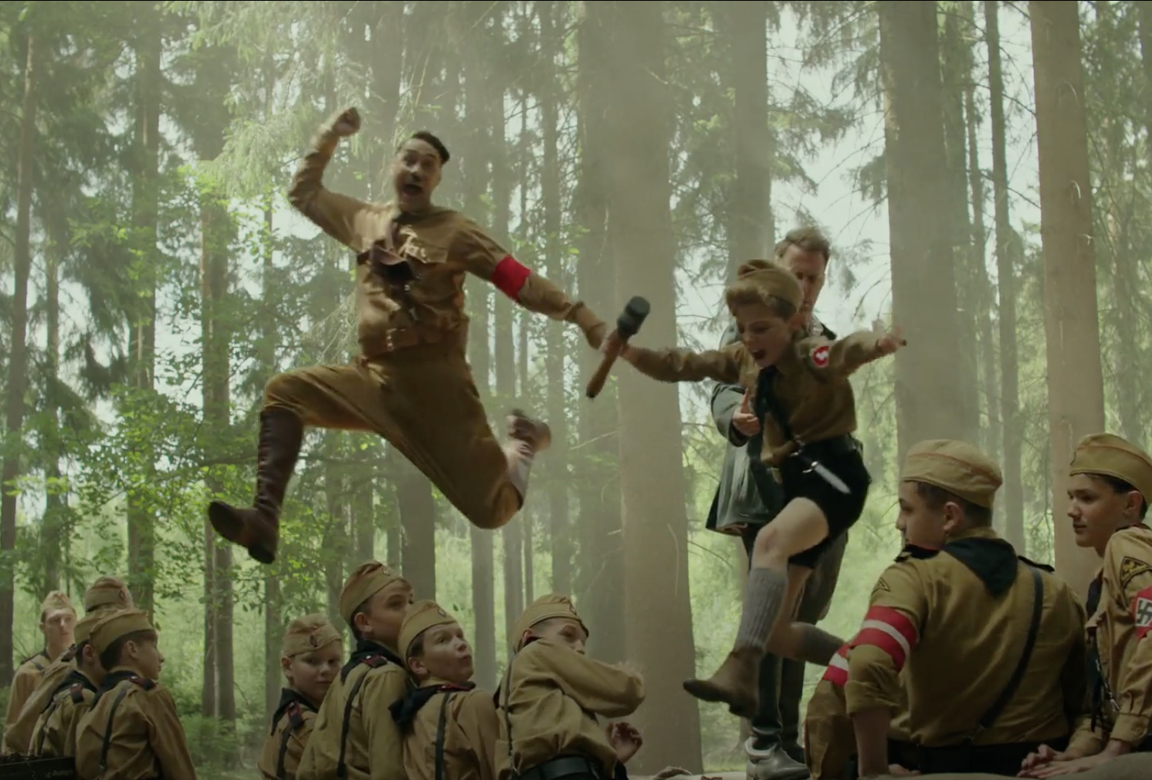
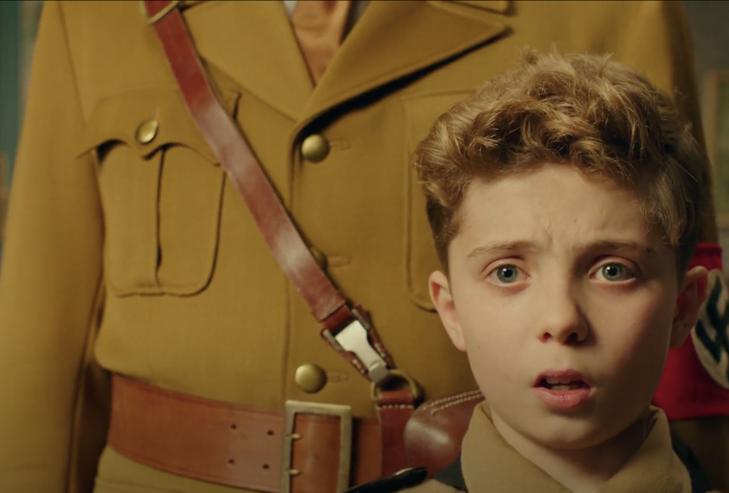
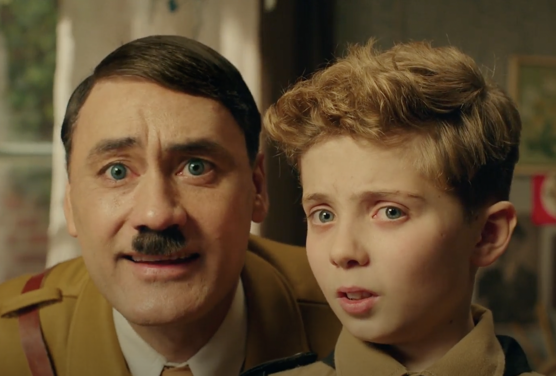
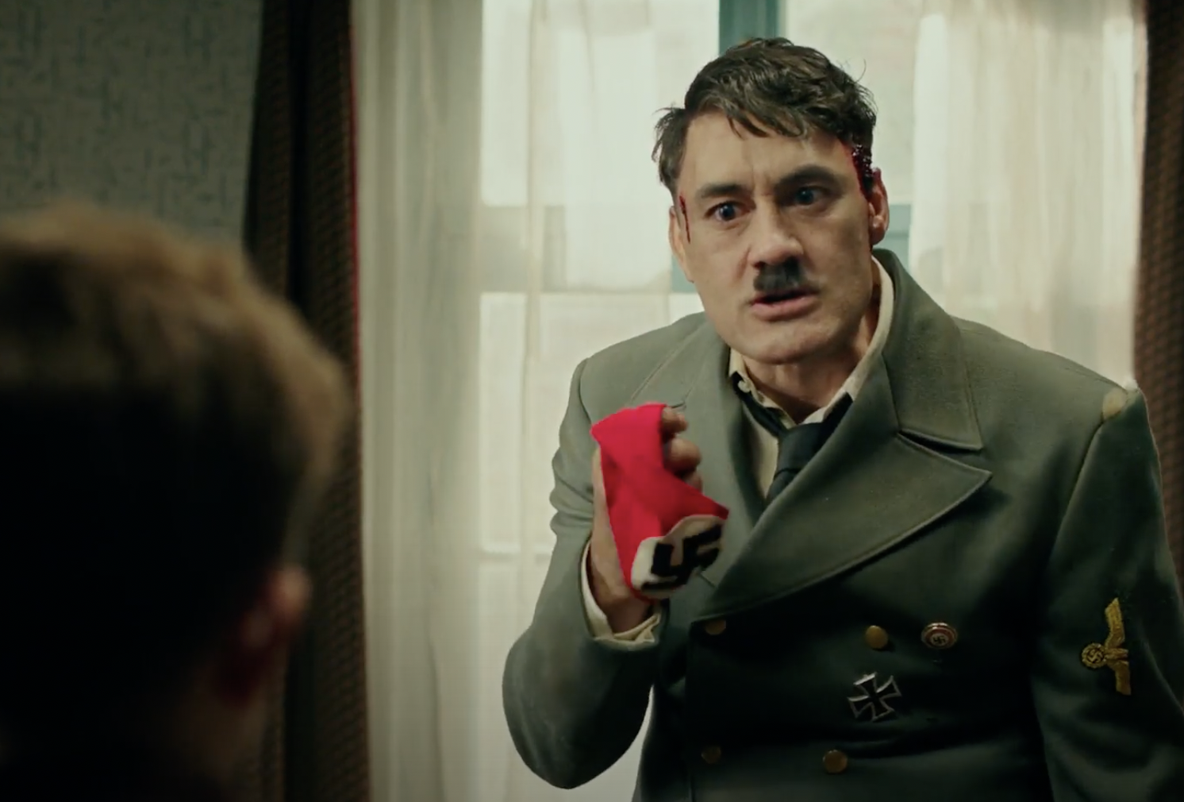
Figure of Hitler in Jojo Rabbit
First appearance with typical attributes: playing with already known images of Hitler
Development of the character: From a silly and childish best friend to the frightening and desperate dictator (with headshot) in the end
Hypothesis: It is not a caricature of Hitler – it is a caricature of already existing depictions of Hitler in mass culture

Slide 11
Bibliography:
Berlant, Lauren, The Female Complaint: The Unfinished Business of Sentimentality in American Culture, Durham: Duke University Press, 2008.
Fulbrook, Mary, Private Lives, Public Faces: On the Social Self in Nazi Germany, in Private life and Privacy in Nazi Germany, ed. by Elizabeth Harvey, Johannes Hürter, Maiken Umbach, and Andreas Wirsching, Cambridge: Cambridge University Press, 2019, pp. 55–80.
Landsberg, Alison, Prosthetic Memory: The Transformation of American Remembrance in the Age of Mass Culture, New York: Columbia UP, 2004.

